Slide 1

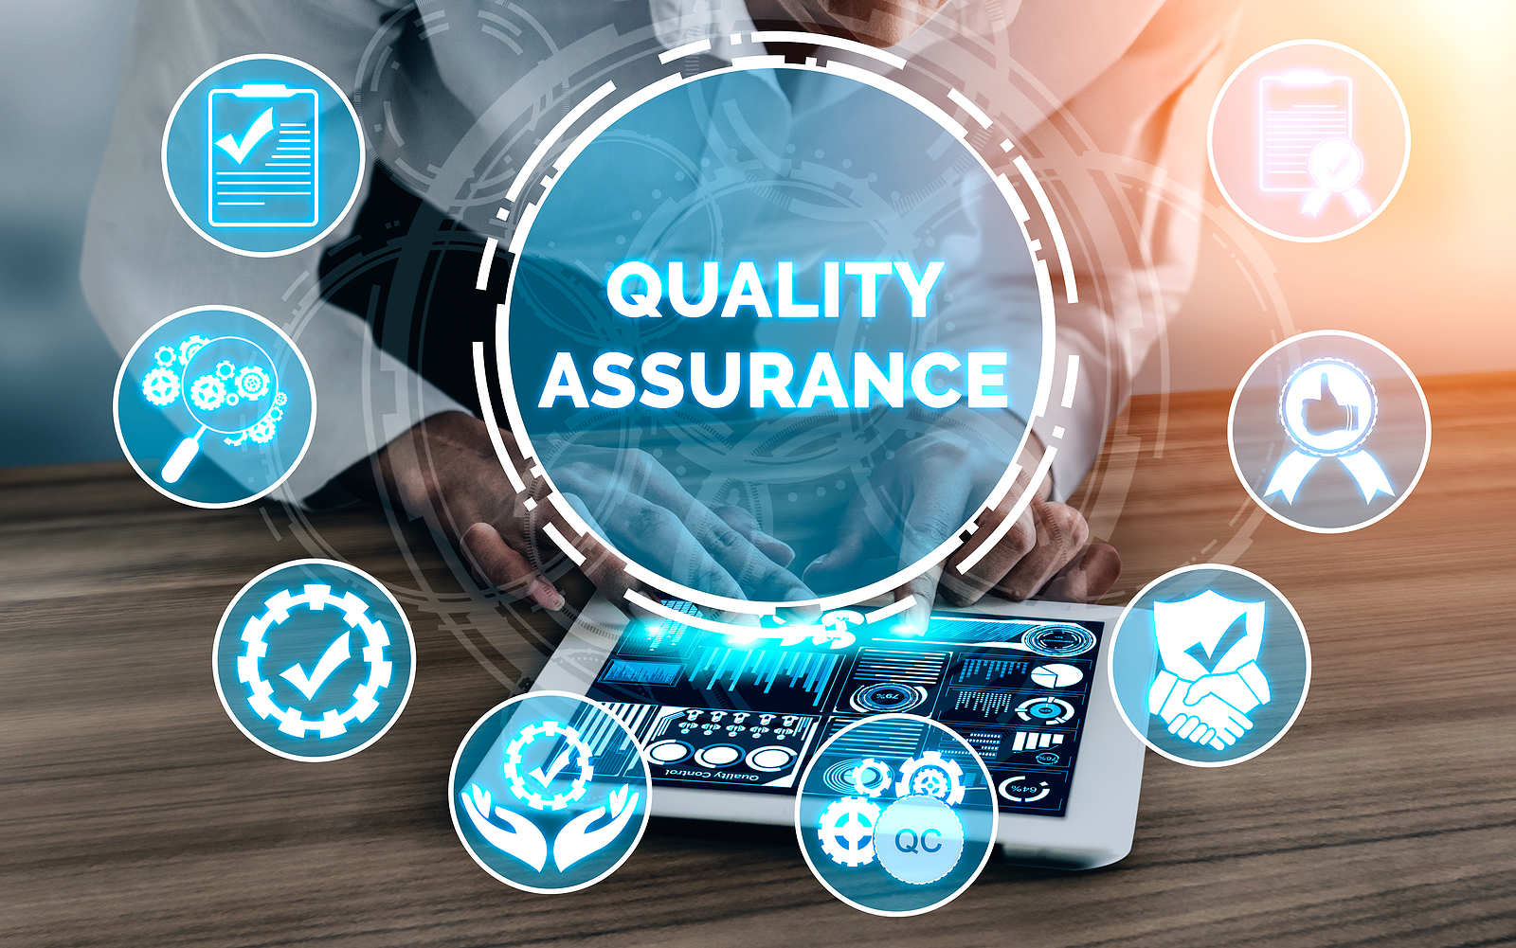
Software Testing Bootcamp
FAST NUCES

Slide 2
Importance of QA
Testing and Quality
QA VS QC
Importance of QA

Slide 3
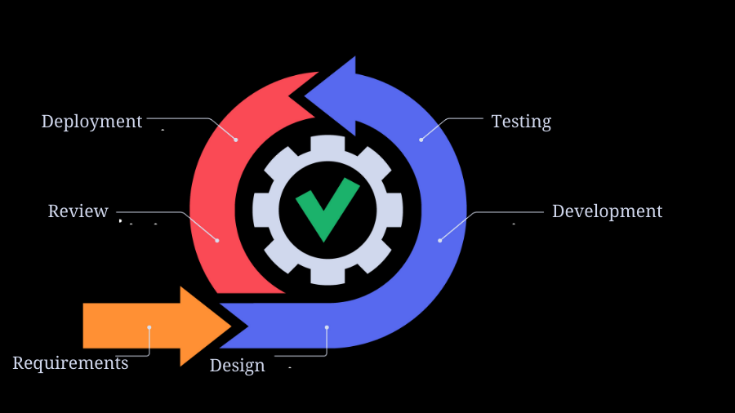
SDLC
SDLC
Role of QA in SDLC which means STLC
Role of QA

Slide 4



Artifacts & Tools
STLC
Requirement grooming
Test Planning
Test cases
Test Environment Setup
Test Execution
Test Closure
TOOLS
Jira
Test Rail
Testworthy

Slide 5
Testing Types
Testing types
Functional
Non-Functional
Integration
API testing
DB testing
Smoke and regression

Slide 6
Automation Testing
What?
When?
Why ?

Slide 7
Benefits of Automation Testing
Efficiency ​​
Repeatability​​
Consistency​​
Regression Testing​​
Parallel Execution
Faster Feedback
Increased Test Coverage
Continuous Integration/Continuous Deployment (CI/CD)

Slide 8
Challenges of Automation Testing
Initial Investment and Learning Curve
Continuous Maintenance
Dynamic User Interfaces
Test Data Management
Environment Configuration
Test Case Selection
Tool Selection
Limited Test Coverage
Integration Challenges

Slide 9
Key Factor of Successful Testing Framework
Collaboration of
Product owners.
Business analysts.
Developers.
Testers and Automation engineers.

Slide 10
Kind of Automation Testing
Web
Mobile
API
E2E

Slide 11





Popular tools for QA Functional Automation
​Selenium
Appium
Playwright
TestCafe
Cypress (etc.)

Slide 12








Popular tools for QA Non-Functional Automation
​ Load Testing
Apache JMeter
Gatling
LoadRunner
Performance Monitoring
New Relic
AppDynamics
Dynatrace
Security Testing
OWASP ZAP (Zed Attack Proxy)
Burp Suite
Nessus

Slide 13
Demo
https://www.youtube.com/watch?v=U6IiQ-fjvwI&ab_channel=HappySpacepalm

Slide 14
Mastering the QA Pathway
Directions/Path of QA's
Attributes and Attitude of QA
What makes you Perfect!
Future of QA | AI, ML, Process Automation
How to achieve target and goals
Interview Guidelines

